Slide 1




LOCATION SYNC
Location-aware remote content management for moving and static displays
Blackbox hackathon problem statement 2
Right content. Right place.

Slide 2

THE PROBLEM
Many displays, many places, some of them moving
SCALE
LOCATION
CONTROL
20.9%
someone approves what goes live; advertisers want proof it played
manual updates do not scale
content must follow the display

Slide 3
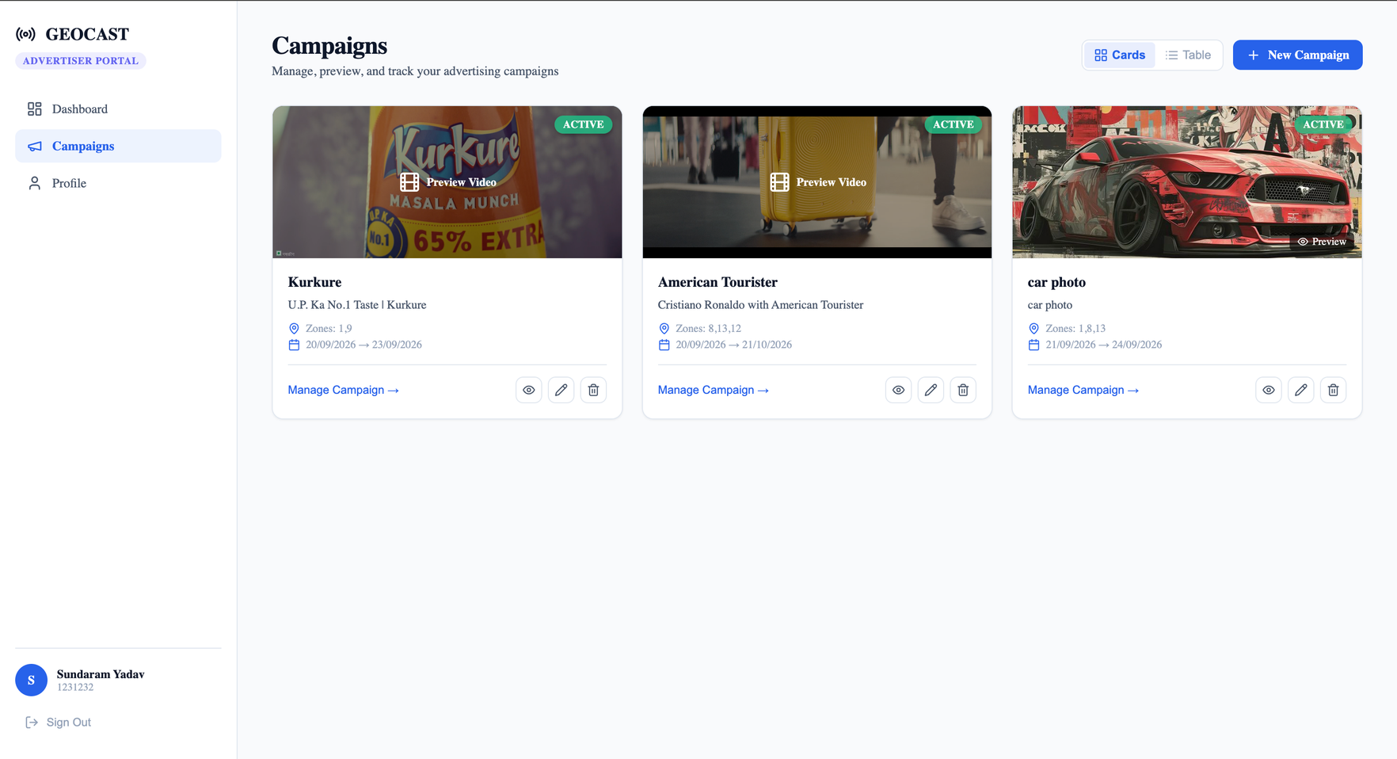
OUR SOLUTION
ADVERTISER PORTAL
upload · target zones/devices · day and time window · play report

Slide 4
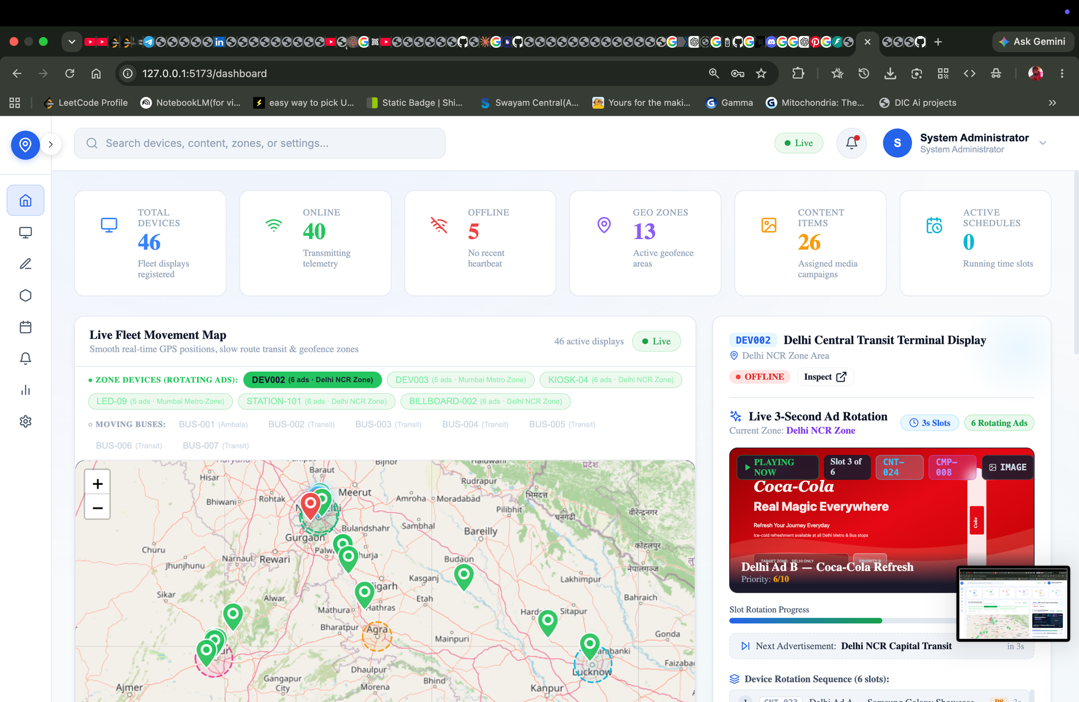
OUR SOLUTION
ADMIN PORTAL
review · confirm schedule · zones and devices

Slide 5
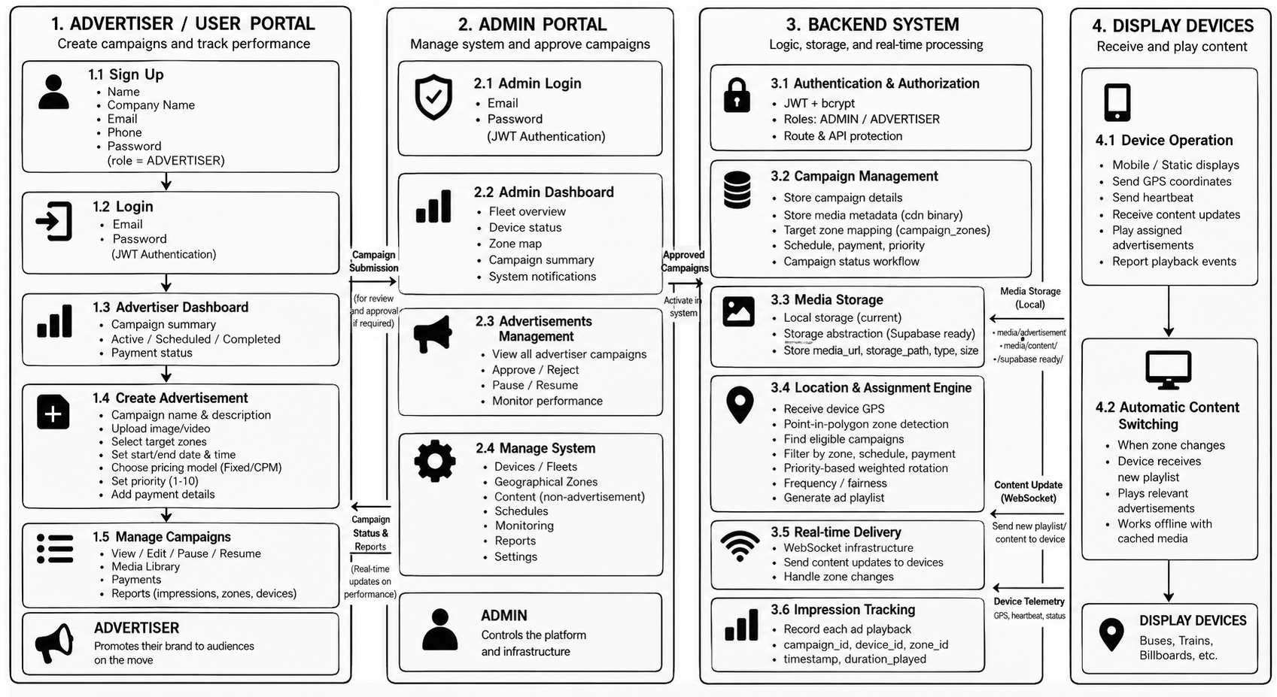

SYSTEM ARCHITECTURE

Slide 6
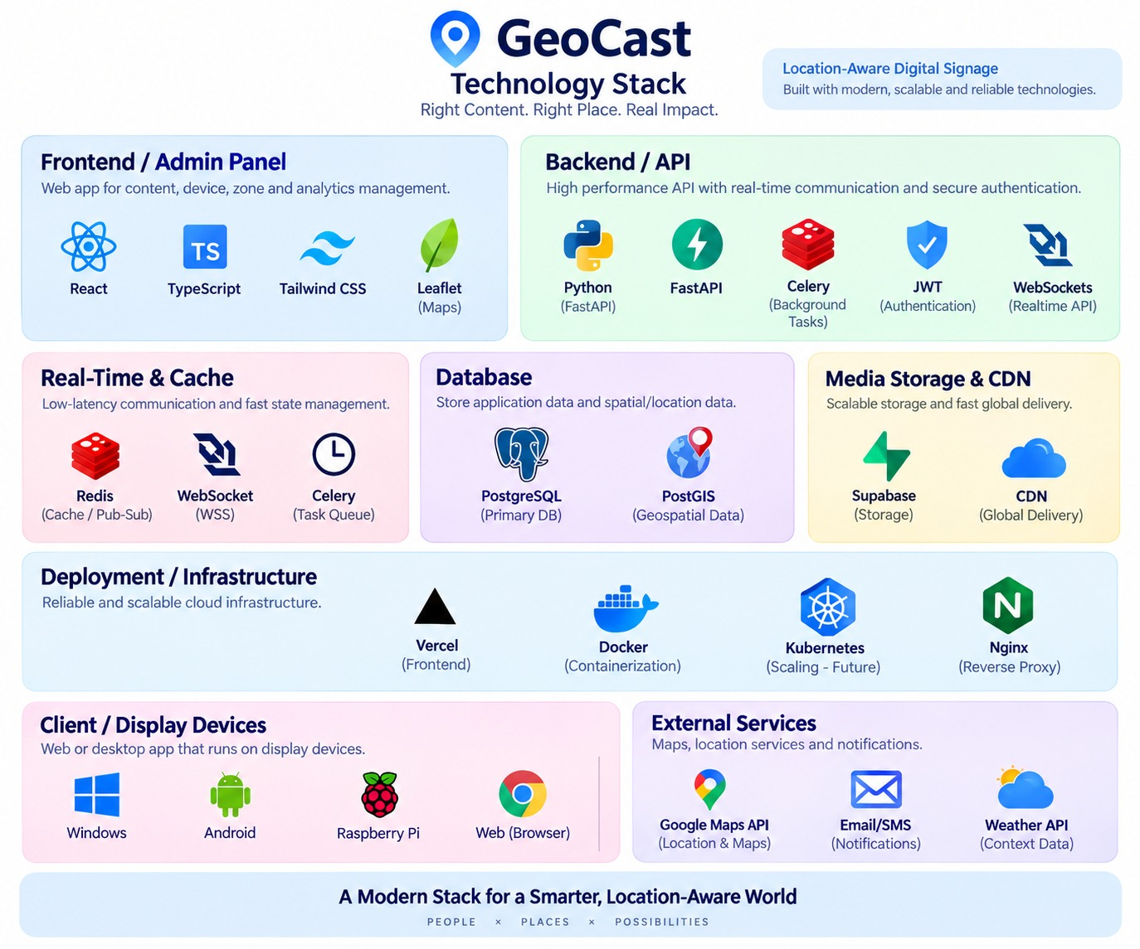

TECH STACK

Slide 7
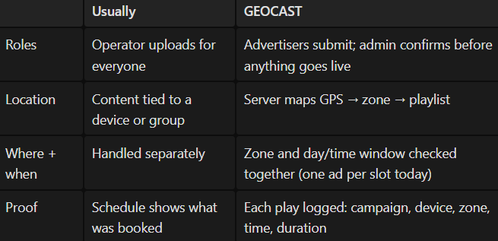
WHAT’S DIFFERENT?
LOCATIONSYNC

Slide 8
FEASIBILITY AND REAL-WORLD USE
Standard open-source stack
One backend, one database, one storage layer runs the full loop
Media cached on the device, downloaded once
JWT and roles; admin approval before anything goes live
Where it fits
  Bus, train, cab-top screens (mobile)
  Billboard and bus-shelter networks (static)
  Multi-city retail promotions

Slide 9

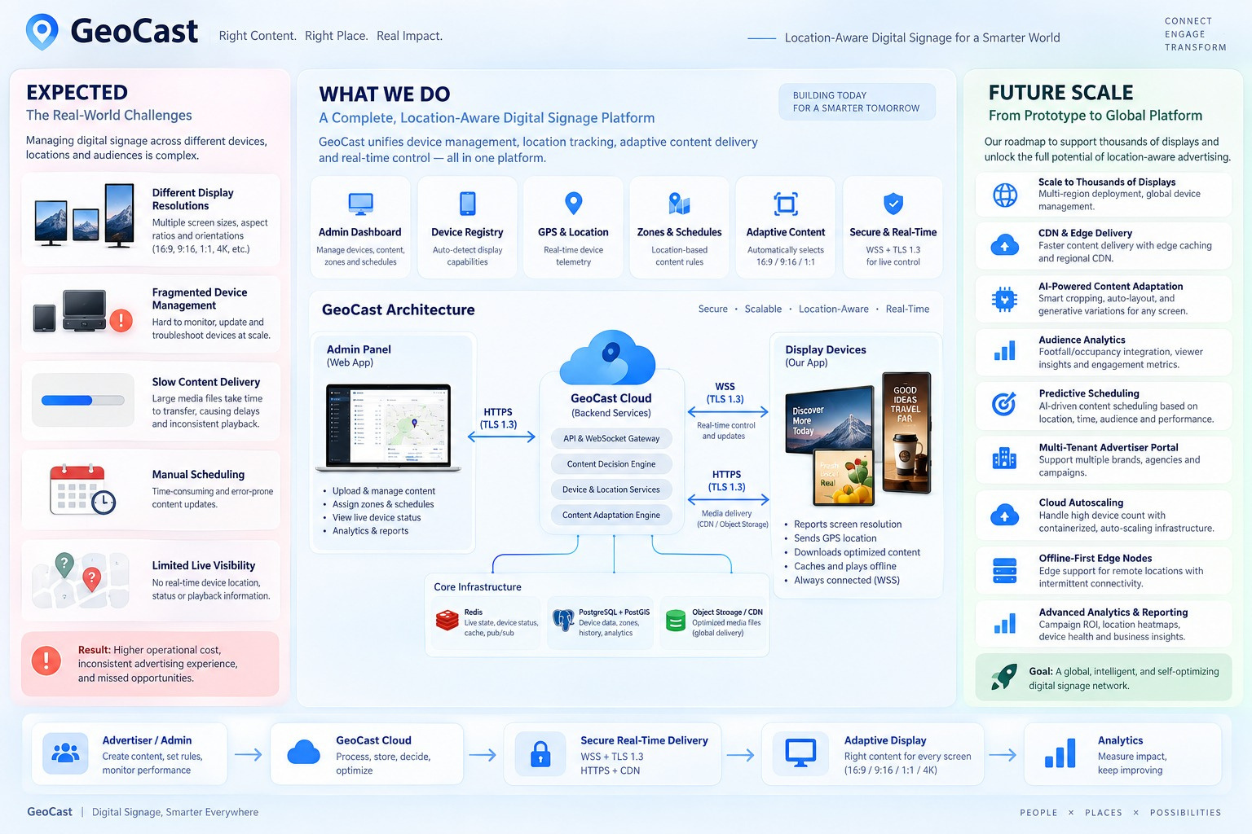
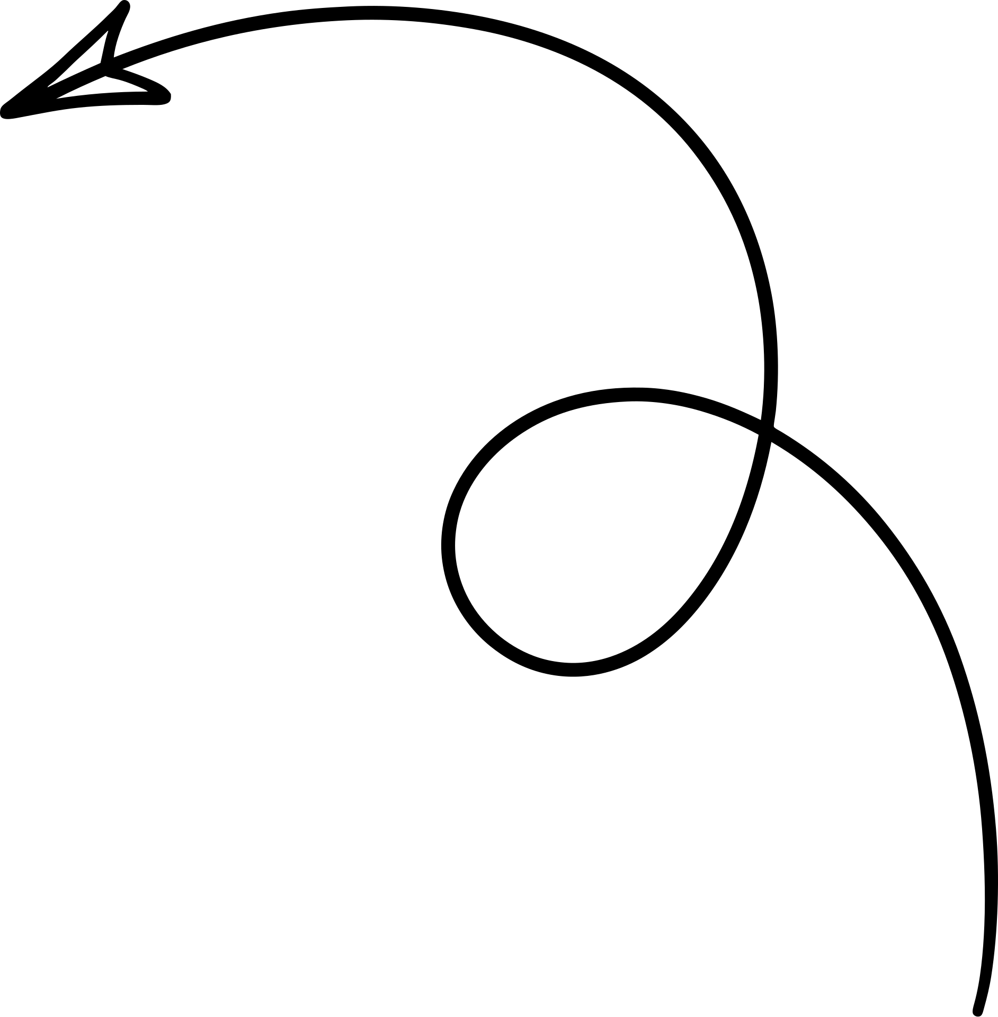

STATUS, LIMITS, SCALE PATH
LOCATION SYNC

Slide 10

THANK YOU
TEAM TRACE

